Slide 1

BPS
Sprint 1.2 Review
Defense Intelligence Agency (DIA)
August 27, 2026
Groundswell

Slide 2
Agenda
01
Sprint Progress
02
Feedback
03
Notes
04
Story Overview
05
Demo
06
Q&A

Slide 3

BPS Program Goals
Consolidate existing PPBE applications (iRMIS and iRMIS-FI).
Create unified data model, lexicon, and ontology across Programming, Budgeting, and Execution.
Improve visibility by providing a solid view of spend plan budget lines to payment, enabling users to analyze and track financial transactions more effectively.
Feature an updated and a user-friendly interface, ensuring a more intuitive and efficient navigation experiences for users.
Seamless data integration across core systems of record (DCIPS, CIVPAY, MyHR, AMS, FACTS).
Leverage Solution-First and Platform Approach using Groundswell Integrated Budget Suite (GIBS) to create the BPS solution.

Slide 4
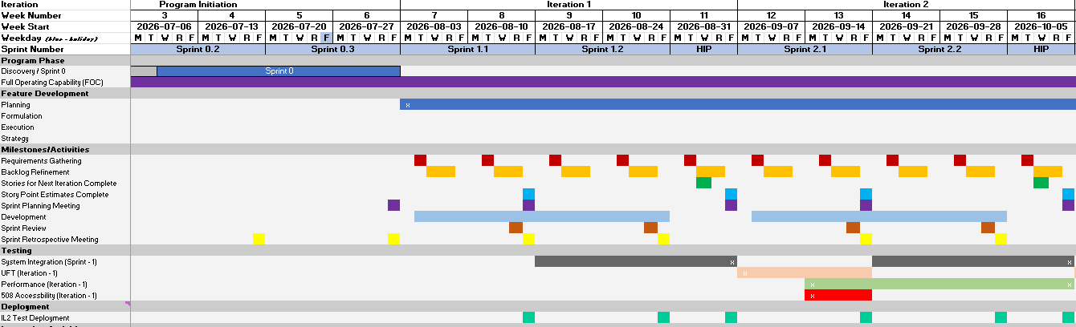
Sprint Overview
Program Details:
2-year FOC (6/2026 – 6/2028)
60 developments sprints (2 completed!)
Current Progress
Completed second development sprint

Slide 5
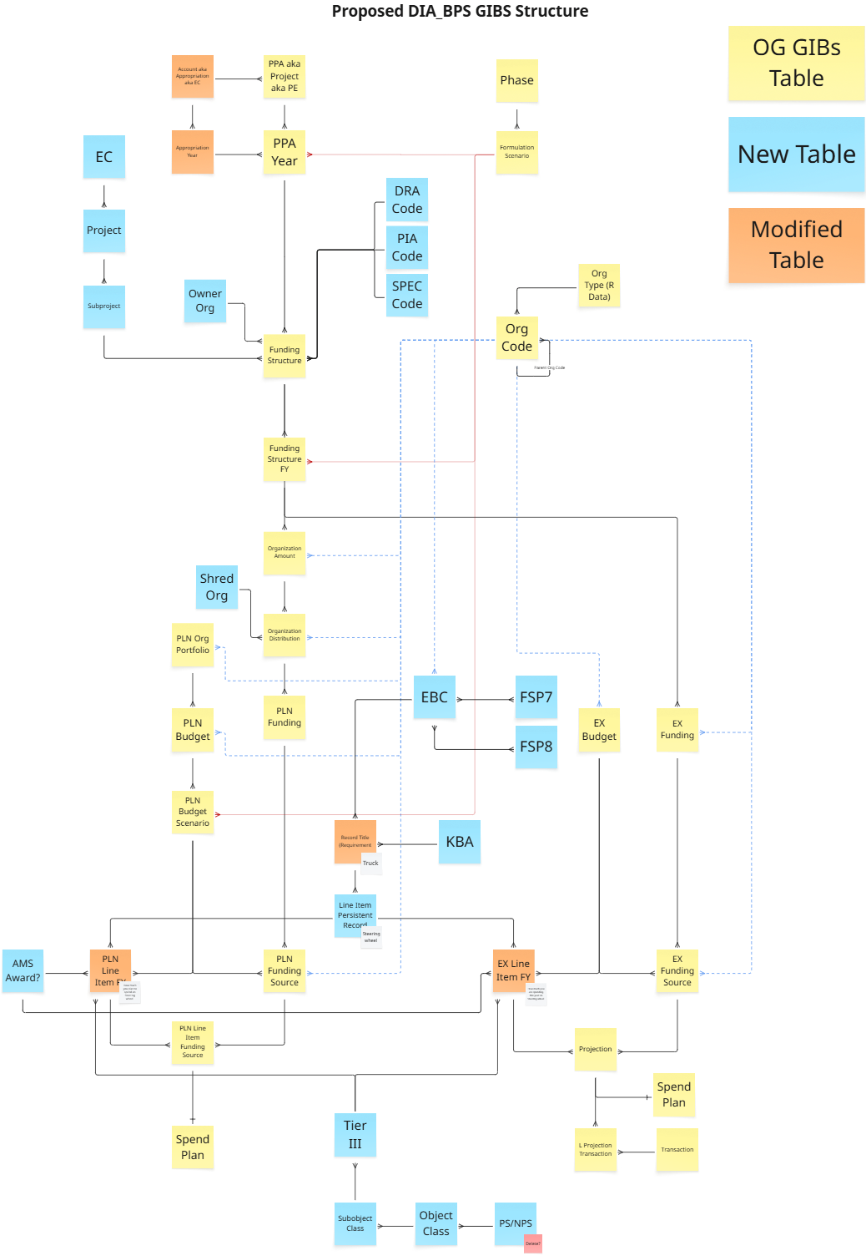
Next Iteration
Iteration 2 Development
Managing foundational data elements
Agile Principles At Work
Agile over Waterfall
Inspect and Adapt
Specification by example
Architectural Principles at Work
Decoupling
Building out lowest-level entities first
End-to-end business process

Slide 6
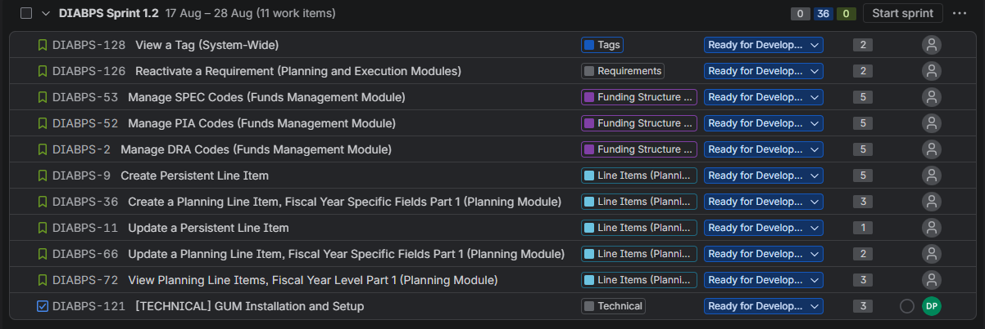
Sprint 1.2 Overview
1.2 Sprint Goal:
Manage foundational data elements (PIA, SPEC, DRA).
Start creation of line items.
(+) View Spec, PIA, DRA codes
(+) BPS Branding

Slide 7
Sprint Velocity

Slide 8
Demo

Slide 9
Feedback
Your input is needed!
Everyone is encouraged to provide feedback
We will pause after each ticket is presented to provide the opportunity to ask questions
  Also utilize the “Raise Hand” and chat features in Teams
Feedback will be tracked and prioritized by the team
  Quick fixes: completed time-permitting
  Larger items will be prioritized for future sprints
Any longer discussions may need to wait until the end of the meeting to allow time for everyone to present

Slide 10

Demo Notes
Work in Progress Banner
  Placeholder used across the application to denote that a page is still under construction
Branding Colors and Icons
  The application look and feel has been updated to include DIA/BPS branding

Slide 11
Story Overview
Ticket Number | Summary | Presenter
DIABPS-123 | [TECHNICAL] Create color scheme/branding for DIA | Noah
DIABPS-126 | Reactivate a Requirement (Planning and Execution Modules) | Noah
DIABPS-167 | View DRA Codes (Funds Management Module) | Noah
DIABPS-2 | Manage DRA Codes (Funds Management Module) | Noah
DIABPS-169 | View SPEC Codes (Funds Management Module) | Jacob
DIABPS-53 | Manage SPEC Codes (Funds Management Module) | Jacob
DIABPS-168 | View PIA Codes (Funds Management Module) | Eugene
DIABPS-52 | Manage PIA Codes (Funds Management Module) | Eugene
DIABPS-128 | View a Tag (System-Wide) | Eugene

Slide 12
Story Overview (cont.)
Ticket Number | Summary | Presenter
DIABPS-36 | Create a Planning Line Item, Fiscal Year Specific Fields Part 1 (Planning Module) | Tommy
DIABPS-9 | Create Persistent Line Item | Aidan
DIABPS-72 | View Planning Line Items, Fiscal Year Level Part 1 (Planning Module) | Mishelle
DIABPS-11 | Update a Persistent Line Item | Mishelle
DIABPS-66 | Update a Planning Line Item, Fiscal Year Specific Fields Part 1 (Planning Module) | Mishelle

Slide 13
Looking Ahead

Slide 14
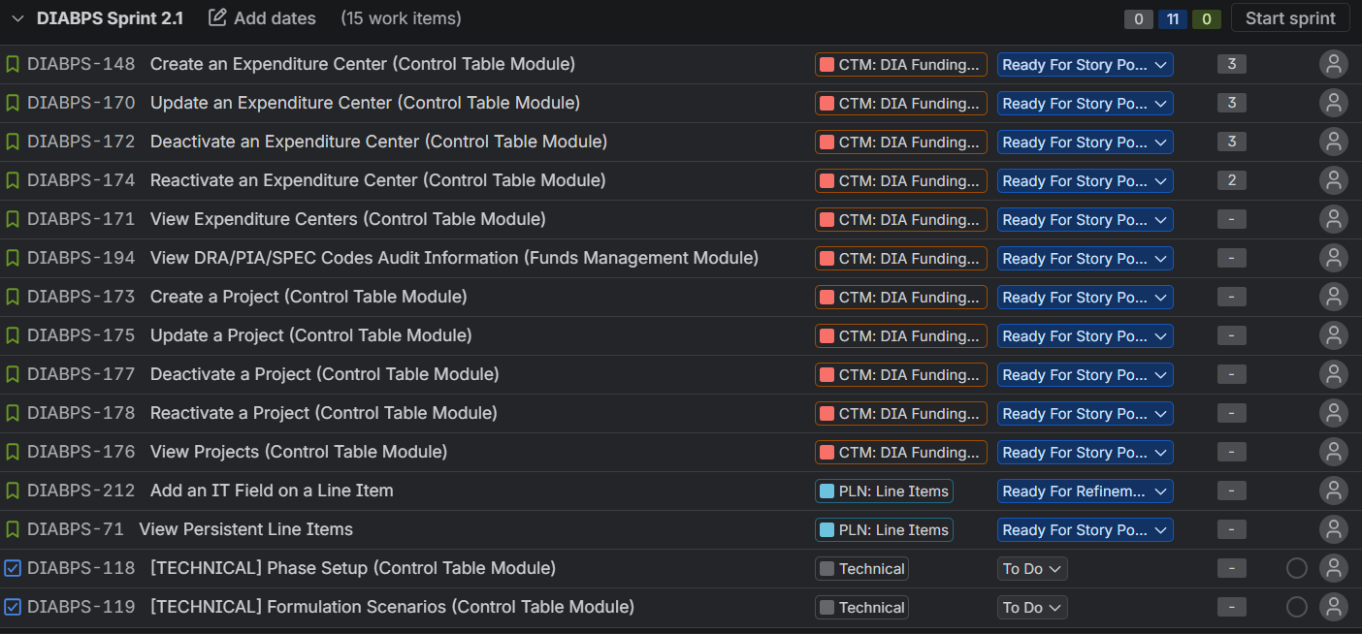
Next Sprint
2.1 Sprint Goal (draft): Continue to validate the BPS data model by redesigning how foundational data is managed (line items, funding structure fields). This is the first step in replacing legacy systems (iRMIS / iRMIS-FI) and unifying the iPPBE process at DIA.

Slide 15
Questions?

